Slide 1

Unemployment and Healthcare
The effects of unemployment on a person's health and wellbeing, specifically heart disease.

Slide 2
Research Questions:
How does unemployment affect heart disease?
How does the analysis differ based on years?
Does the analysis have statistical significance?

Slide 3
Breakdown of Tasks:
Identify the data that will be used with the timeframe.
Analyze the data to find trends or lack thereof.
Create charts to present the findings.
Implications of findings (what do they mean)
Identify the limitations of the analysis or data used.

Slide 4
Datasets Used:
Bureau of Labor Statistics (BLS)
Unemployment datasets from 2014 to 2021
Centers for Disease Control and Prevention (CDC)
Heart disease mortality rates from 2014 to 2021

Slide 5
Breakdown
We gathered data between the years of 2014 and 2021 for large enough spread of data to illustrate a trend.
Downloaded U.S. unemployment data from “Employment Situation Summary” off the BLS website between the years of 2004 and 2021.
Downloaded U.S. heart disease data from “Heart Disease Mortality by State” off CDC website between 2014 and 2021.

Slide 6
Cleaning Up
Initially, we wanted to do 16 points of data, but we came to find out that the CDC omitted data between the years of 2006-2013 for our heart disease data.
One challenge we faced was attempting to collect data from CDC WONDER to fill in for the omitted years, but we were unable to find the specific criteria for “Heart Disease Mortality by State”. So, we limited our data between the years of 2014-2021 for both mortality total from heart disease and the total number of unemployed.
Another challenge was working with some unreadable data from our heart_data.csv file which, James Wrenn (our TA), swiftly came to our rescue and shared the realistic takeaways from this exercise. We diagnosed the issue of incorrect totals due to hidden quotation marks within the csv file. We confirmed by copying data into a text file and removing quotations, pasting it back into the CSV file, and then fixing it by changing the format of the column to “Numbers” within Excel.
Once data was readable, it was cleaned up by adding up the mortality total from heart disease of each state per year using group by and sum.

Slide 7
What We Saw
Plotted the years and mortality total from heart disease as one line graph and the years versus unemployed total as another line graph.
Plotted the line graphs against each other, and it was unremarkable, but we noticed that we were comparing two y-values that did not complement each other.
SO, we made two different y-values to better fit and compare our data.
The unemployment number and heart disease mortality total intersected once between 2015-2016
both showed to trend upward from 2019, converging in 2020
Then quickly diverging the following year

Slide 8
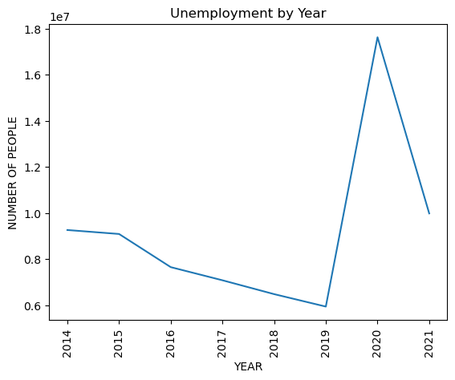
Plotted years versus unemployed total as another line graph.

Slide 9
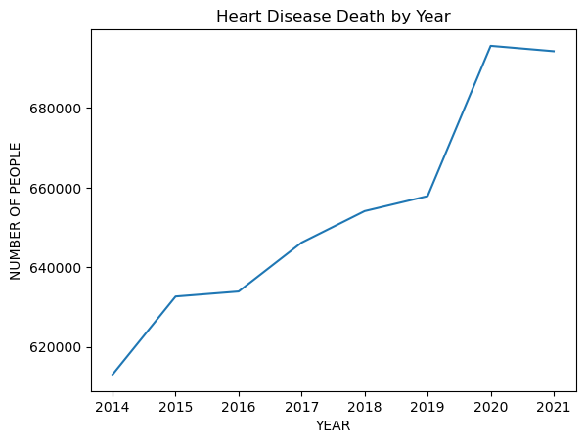
Plotted the years and mortality total from heart disease as one line graph and the

Slide 10
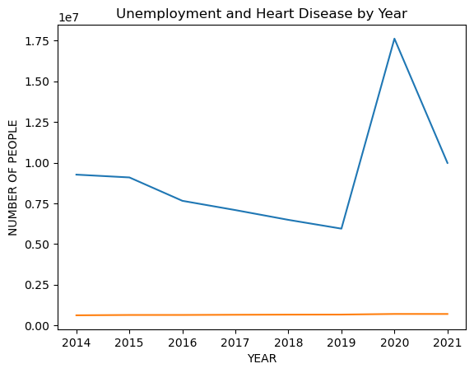
Plotted the line graphs against each other, and it was unremarkable, but we noticed that we were comparing two y-values that did not complement each other.

Slide 11
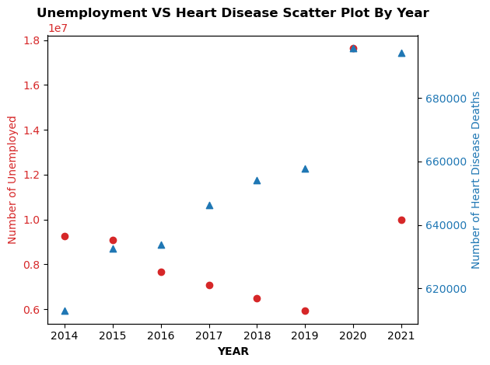

Slide 12
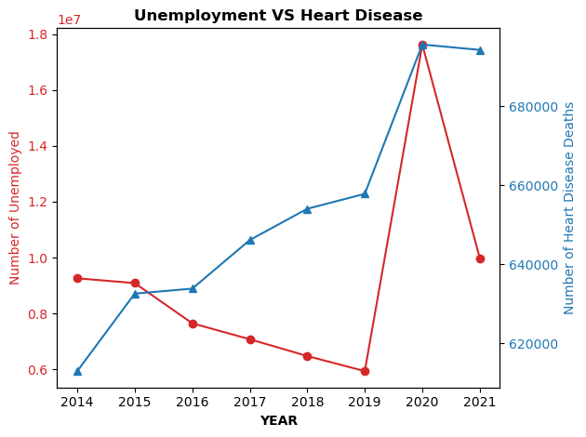
So, we made two different y-values to better fit and compare our data.
The unemployment number and heart disease mortality total intersected once between 2015-2016
Both showed to trend upward from 2019, converging in 2020
Then quickly diverging the following year.

Slide 13
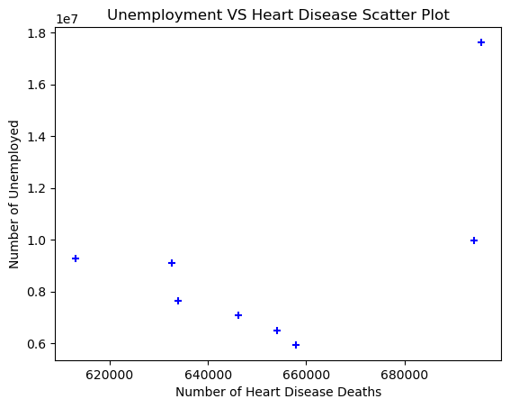
Correlation Coefficient = 0.54

Slide 14
Data Predictions
Even though we were dealing with the millions for unemployment and comparing it to the hundreds of thousands for heart disease mortality, there were still points of intersection for us to suspect an interaction between the two.
Beginning in 2014 we see unemployment rise while heart disease mortalities decrease, so as the years go on heart disease has a significant effect meanwhile unemployment steadily rises indicating the years have significant effect.
They intersect one another from opposite directions in between 2015-2016 showing us the effects of each passing year.
In 2019 the two lines rise at the same time and converge with one another, indicating a possible significance since years affects the rise of total number of unemployment and heart disease mortality.
Immediately after converging they diverge into opposite directions indicating that the each respective y-values have a significant effect.

Slide 15
Statistical Significance
Using the correlation coefficient we found that Unemployment and Heart Disease Deaths are moderately correlated so we cannot confidently say that the unemployment affects the mortality of heart disease or any development of it. We can possibly see the opposite effects of unemployment or that other external factors such as world events independently affect the unemployment numbers and heart disease mortality.

Slide 16
Data Limitations Disclosure
We were limited to the criteria for “Heart Disease Mortality by State” from the CDC data and the years provided. If we had more time, we could have made our own criteria to add up all heart disease mortalities for different age groups that have jobs and we could have compared different age groups for each year to see any trends.

Slide 17
Works Cited
The Centers for Disease Control and Prevention. Heart Disease Mortality by State, https://www.cdc.gov/nchs/pressroom/sosmap/heart_disease_mortality/heart_disease.htm)https://www.cdc.gov/nchs/pressroom/sosmap/heart_disease_mortality/heart_disease.htm. Accessed 02 Oct. 2023.
U.S. BUREAU OF LABOR STATISTICS. Employment Situation Summary, https://www.bls.gov/charts/employment-situation/civilian-unemployment.htm. Accessed 02 Oct. 2023.

